Slide 1
How to print Result Reports
CMS
Directorate of IT
University of Malakand

Slide 2
Table of Contents
How to print Result Report
How to print Tabulation Report
How to print student Transcript
<number>

Slide 3
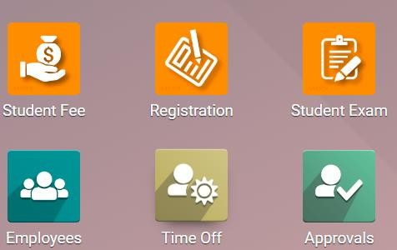
How to print Semester Result Report
When results of all courses in a particular semester are submitted the next step is to print semester result report. which contains student wise details of (obtained Marks, and SGPA).
To print semester Result Report open registration module.
<number>

Slide 4
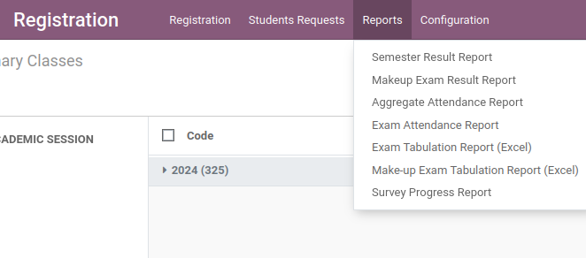
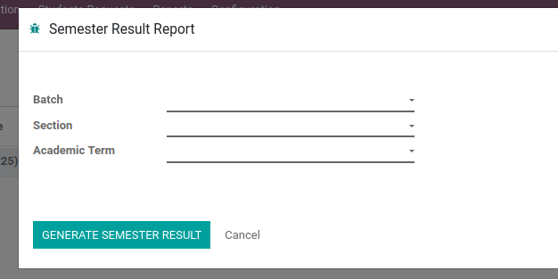
Steps to Generate the Semester Result Report:
Click on the Reports menu.
A drop-down list will appear showing different report options.
Select Semester Result Report from the drop-down
A form will open containing the following fields:
Batch
Section (Morning, Evening)
Term
Select the appropriate Batch, Section, and Term from the drop downs
Click on the green button labeled GENERATE SEMESTER RESULT.

Slide 5
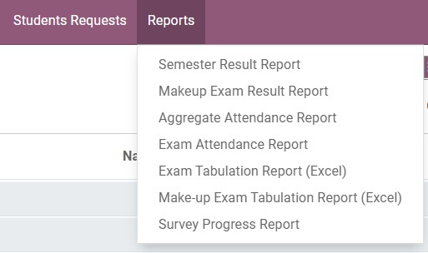
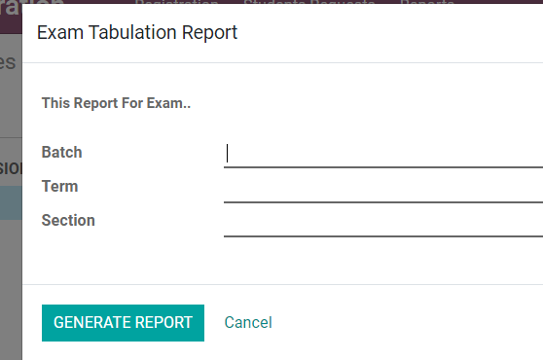
How to print Tabulation Report
To generate Exam tabulation Report:
Go to registration module then click on Reports Menu.
Click on Exam Tabulation Report (Excel)
Then Select the “Batch”, ” Term ” and “section”
Then Click on generate Report Button, system generate the tabulation report.

Slide 6
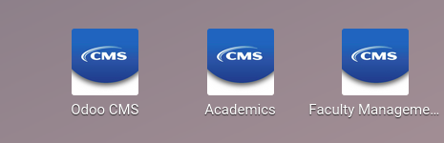
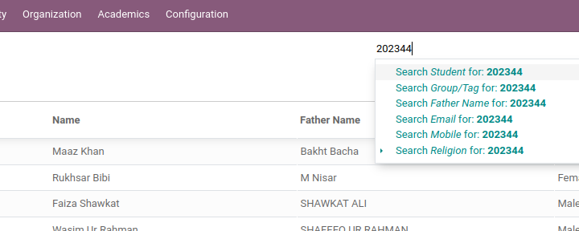
How to print Student Transcript
To print single Student Transcript
Open Odoo CMS Module
search student by ‘Name or Registration Number’.

Slide 7
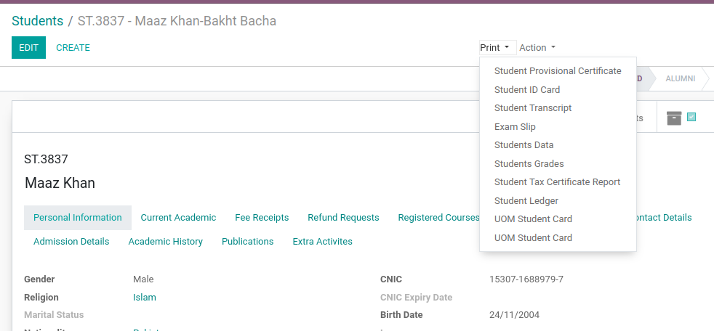
Open Student Record.
Click on print button then
Student Transcript

Slide 8
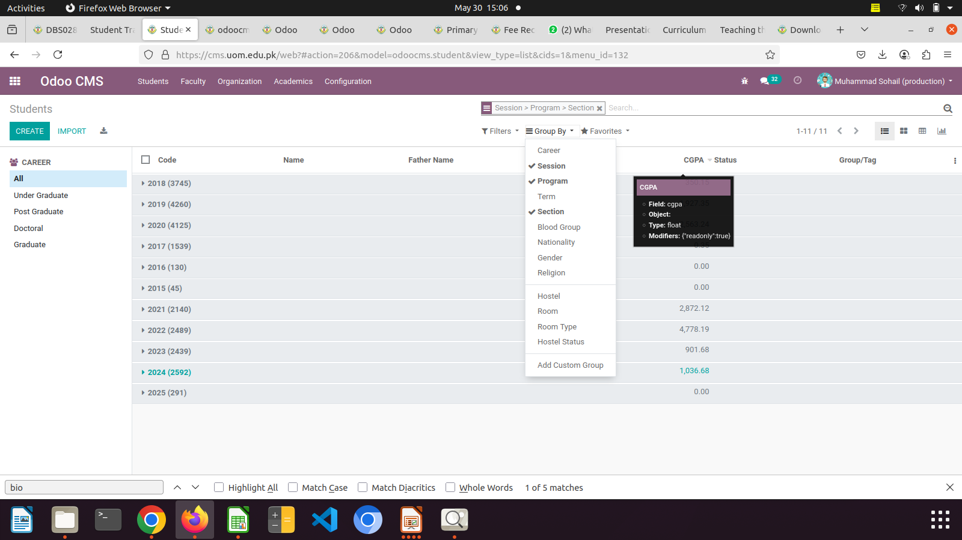
To print all students Transcript
First Group students
In Group By Select
Session Program and Section. System will group student session wise program and section (Morning and Evening)

Slide 9
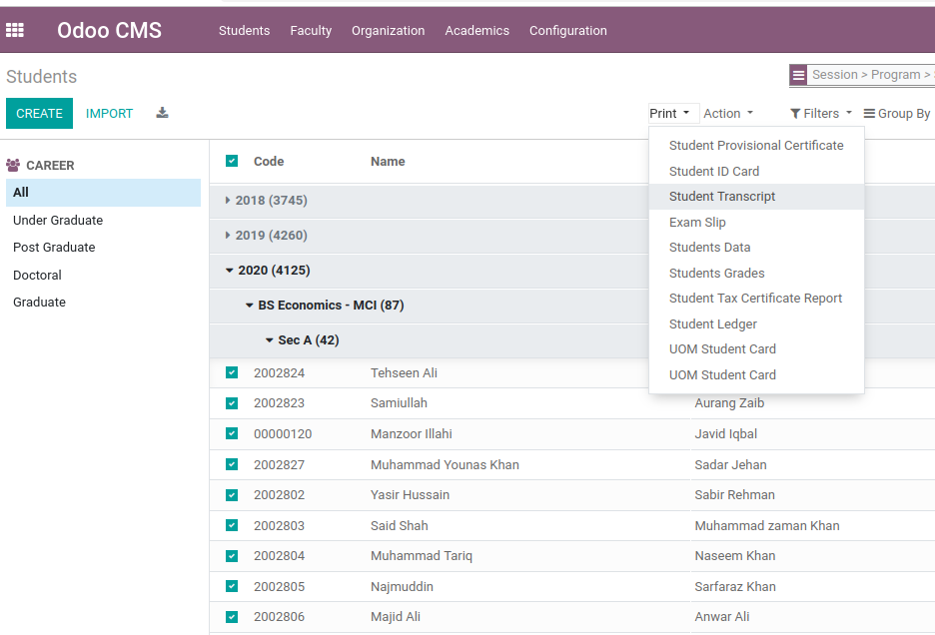
Open Session for which you want print transcript
Then Click on Check box present at the top with code.
Then Click on print button and click Student Transcript.

